Slide 1

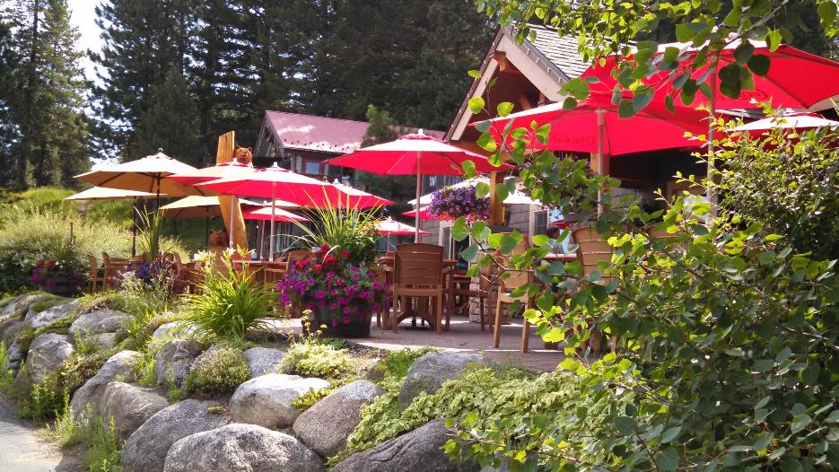
Creating
Beautiful and Vibrant Communities
AmericaInBloom.org

Slide 2
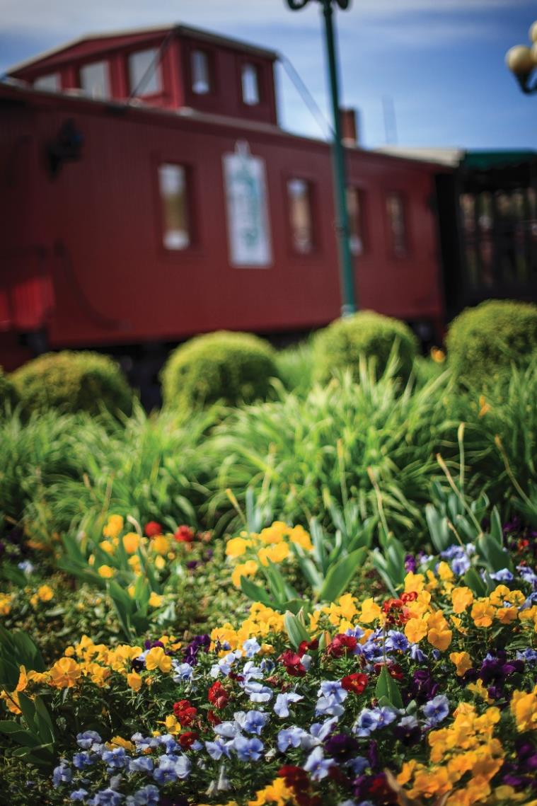
America in Bloom
Vision: America in Bloom envisions communities across the country as welcoming and vibrant places to live, work, and play - benefitting from colorful plants and trees; enjoying clean environments; celebrating heritage; and planting pride through volunteerism.
Mission: America in Bloom promotes nationwide beautification through education and community involvement by encouraging the use of flowers, plants, trees, and other environmental and lifestyle enhancements.

Slide 3
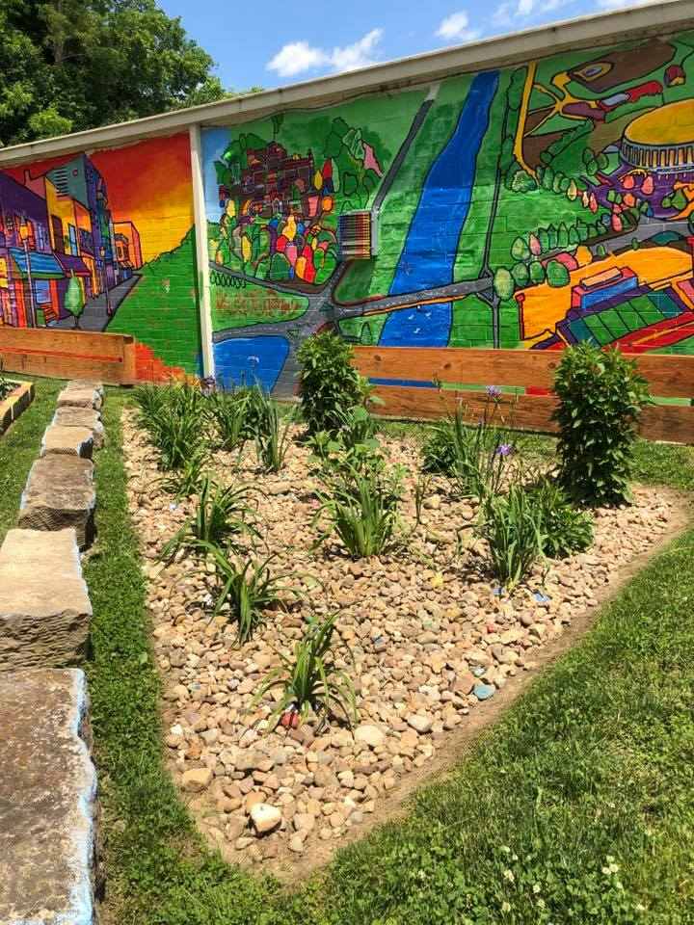
Level 3: Celebrate Your Community
350+ communities in 43 states
Continuing community enhancement programs that encourage volunteer community leadership in coordination with municipal efforts in an ongoing commitment to community vitality, beautification, environmental stewardship, and the celebration of heritage
Brings together volunteers, city government, and the business community
Fosters better cooperation because everyone is working toward common goals
Two-person team of Advisors provides a two-day in-person evaluation of a community.
Advisors provide a written report/consultation with metrics
Advisors are landscape designers, arborists, botanical garden professionals, educators, heritage preservationists, environmentalists, former mayors, and other horticulture professionals
Eligible for national awards (x24)

Slide 4
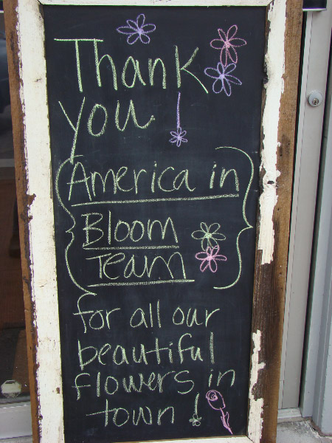
Areas of Impact
  Floral Impact
  Landscaped Areas
  Urban Forestry
  Environmental Initiatives
  Community Vitality
  Celebrating Heritage
  Overall Impression

Slide 5
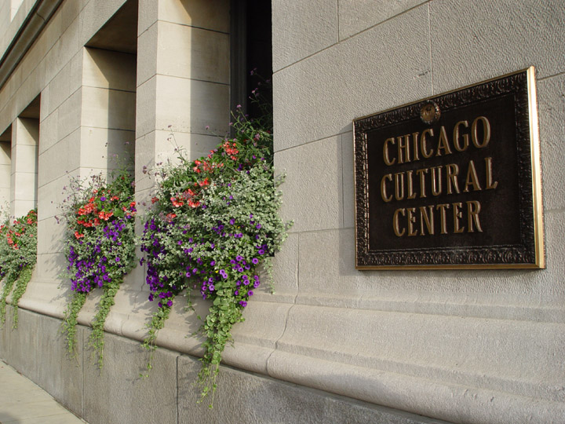
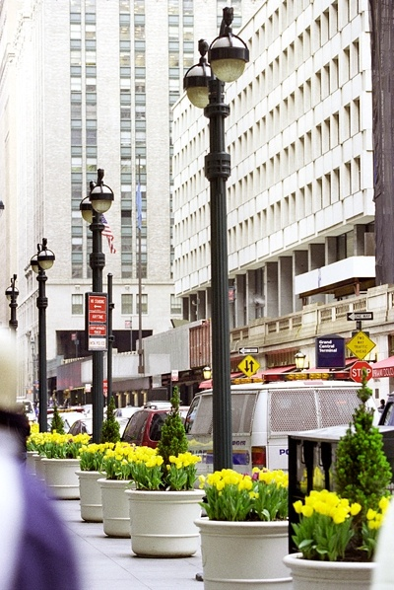
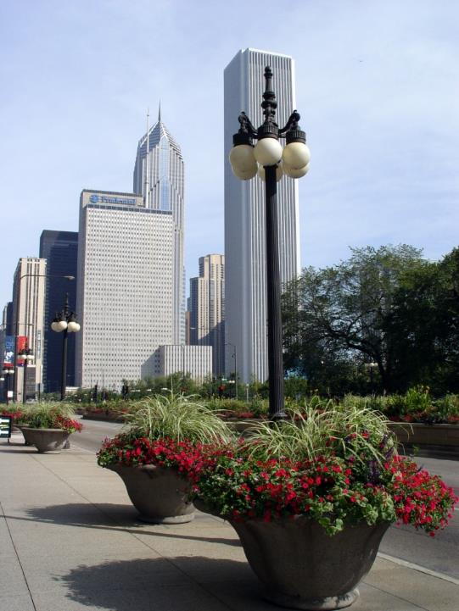
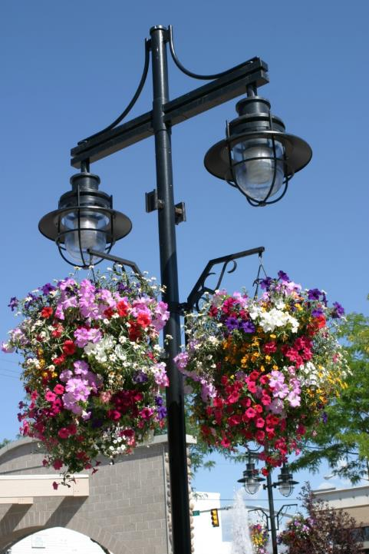
Floral Impact

Slide 6
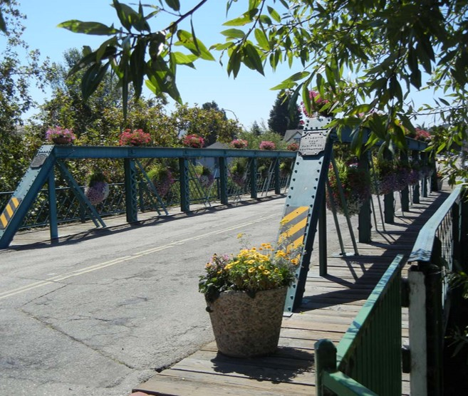
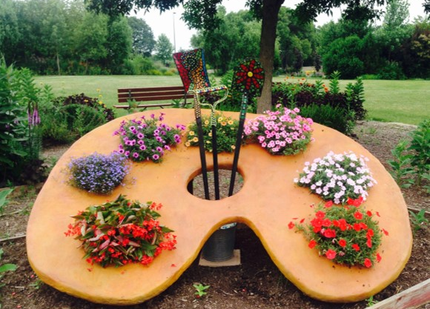
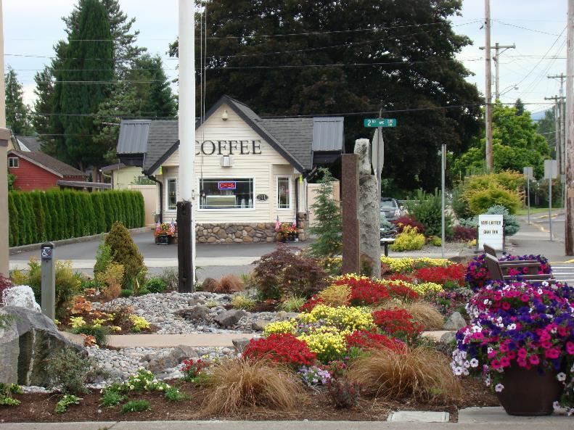

Slide 7
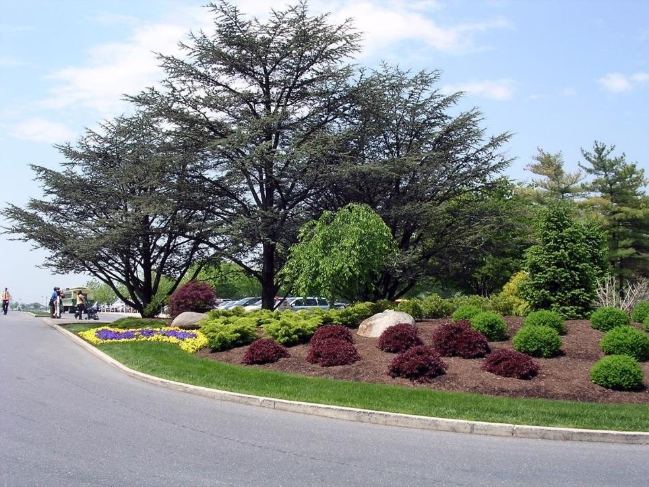
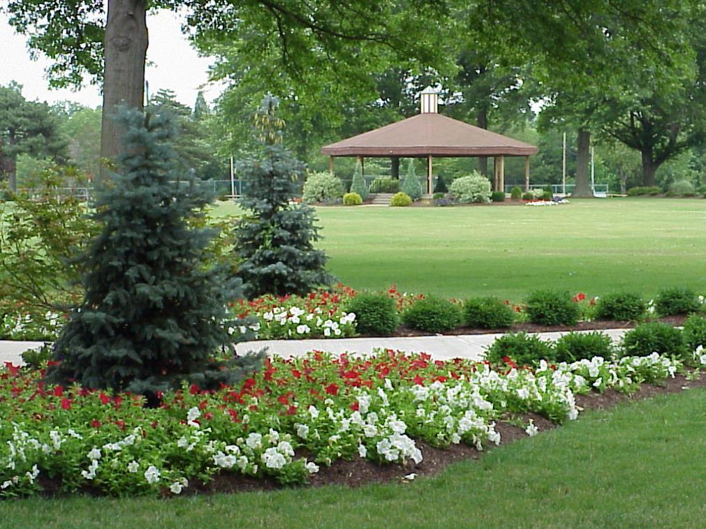
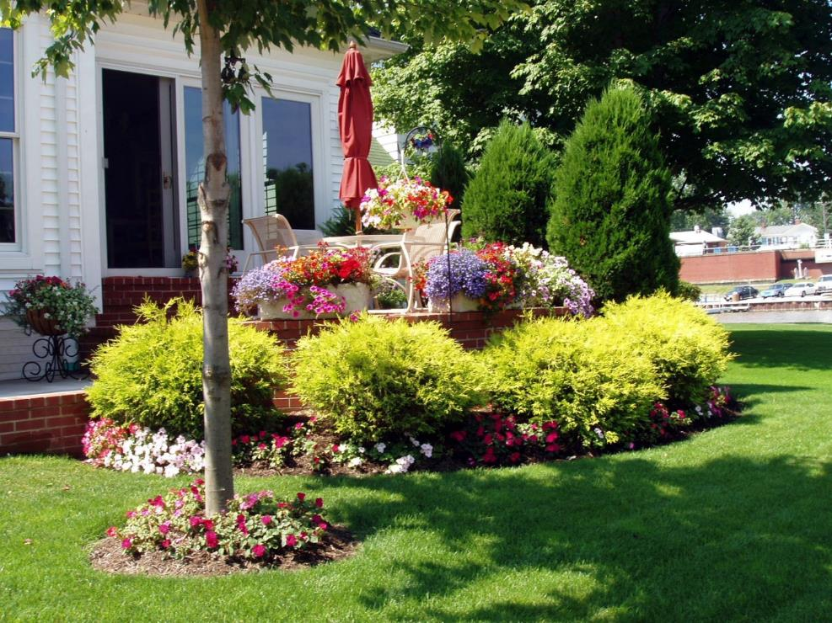
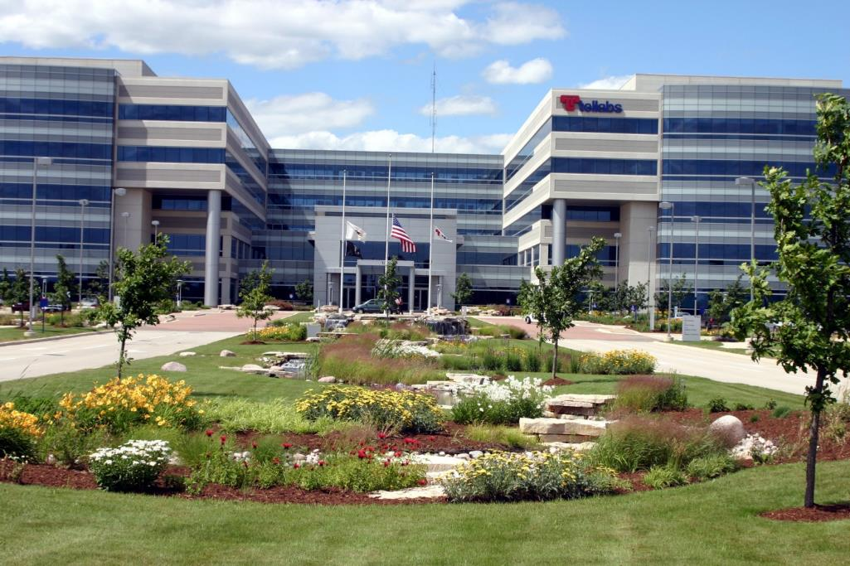
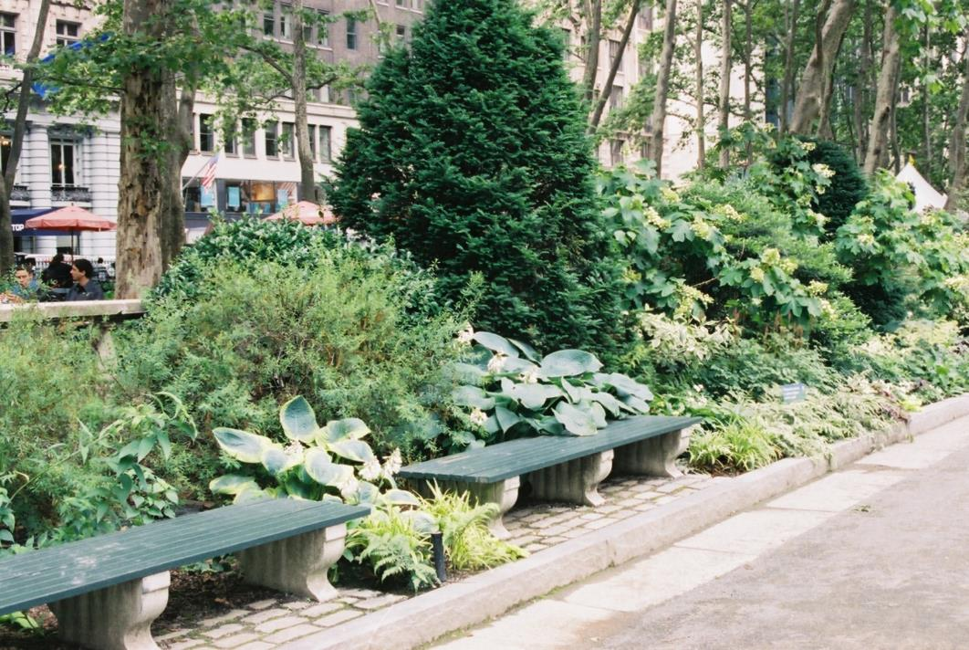
Landscaped Areas

Slide 8
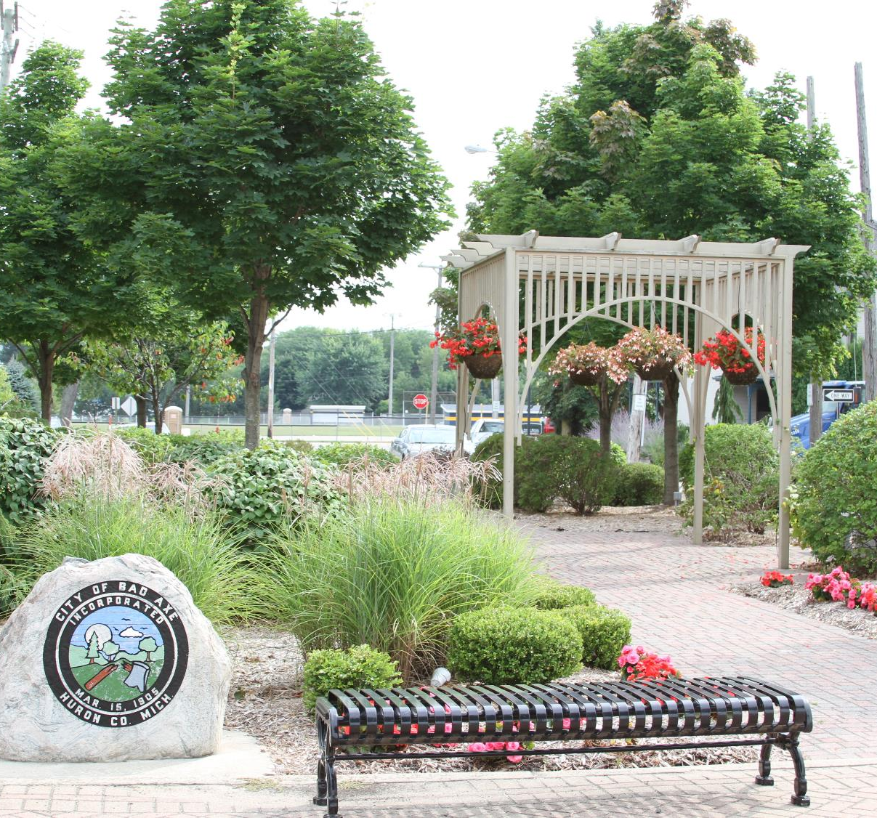
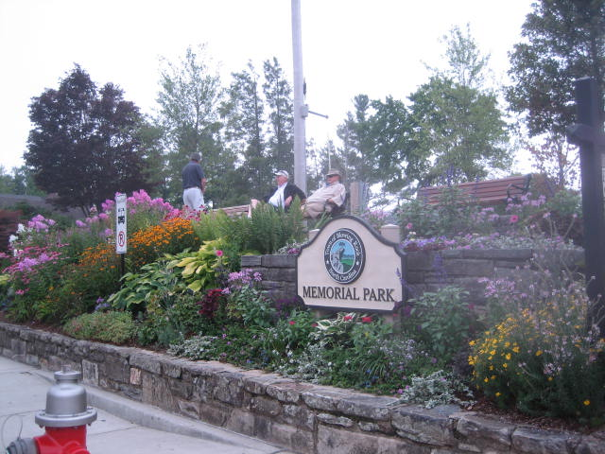
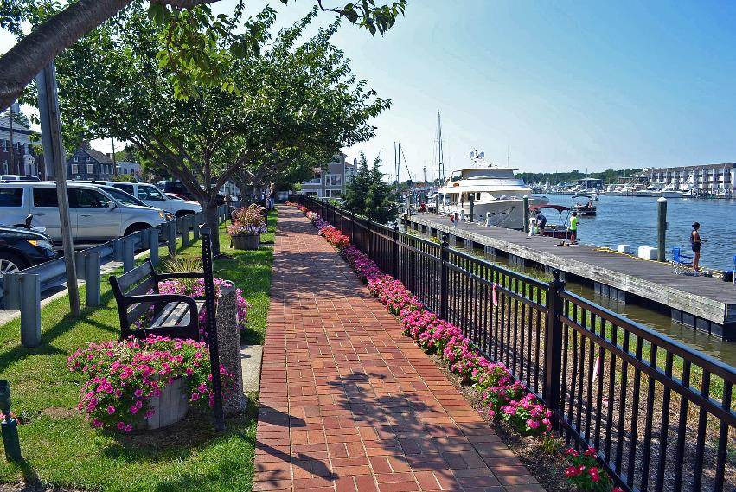

Slide 9
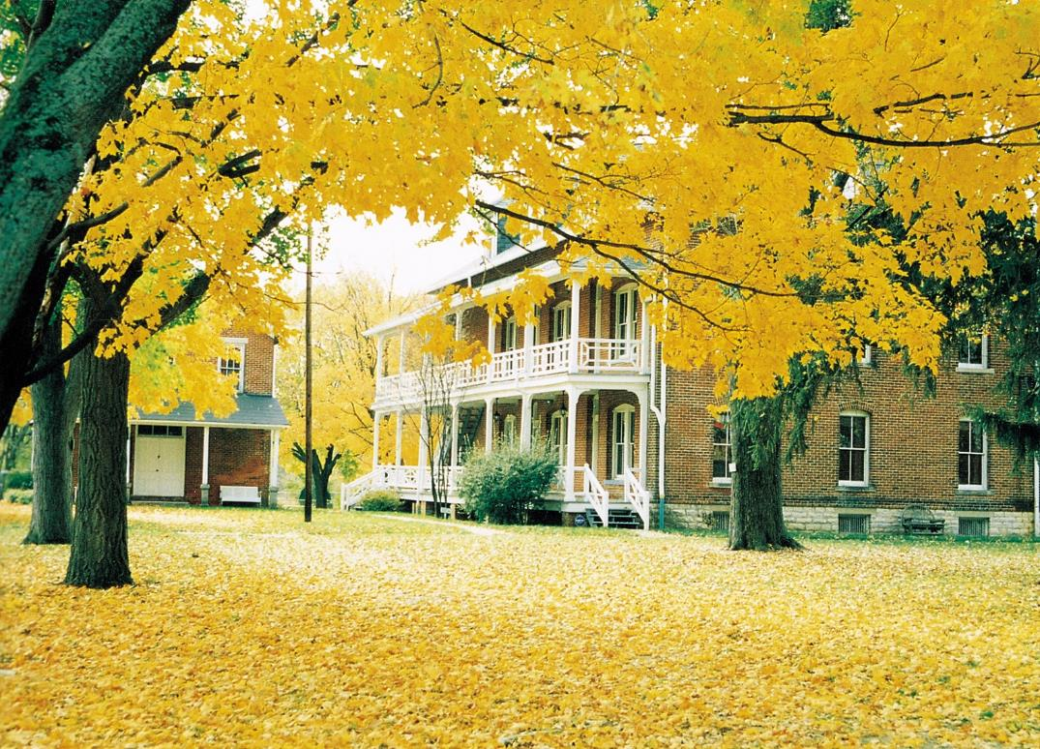
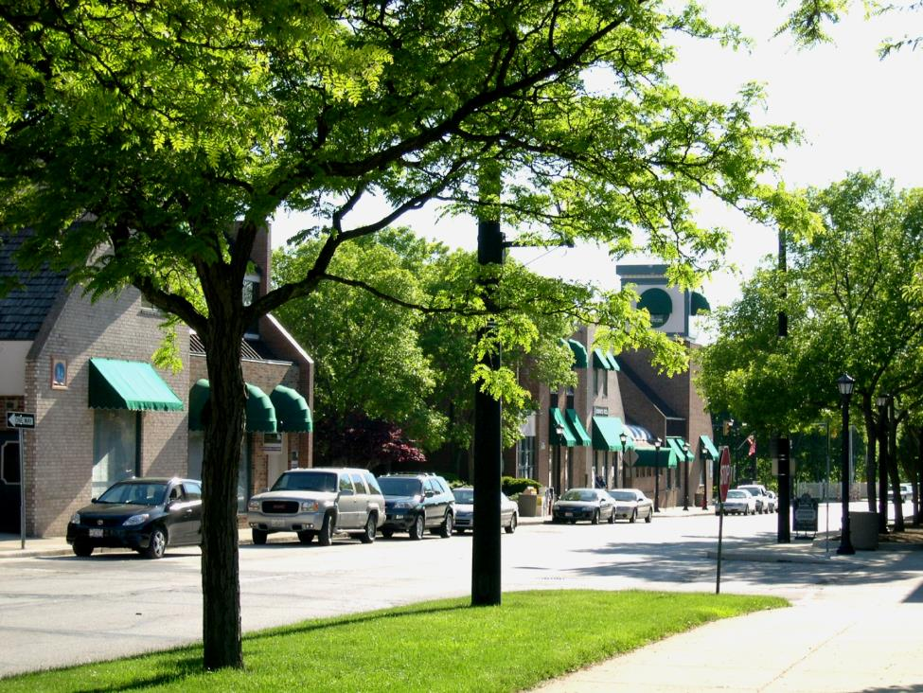
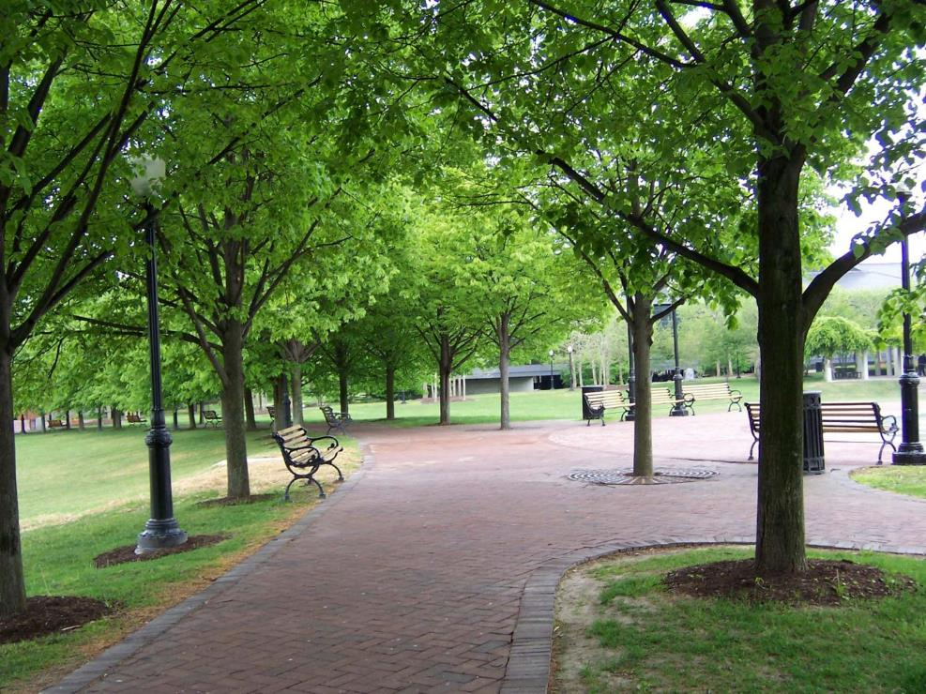
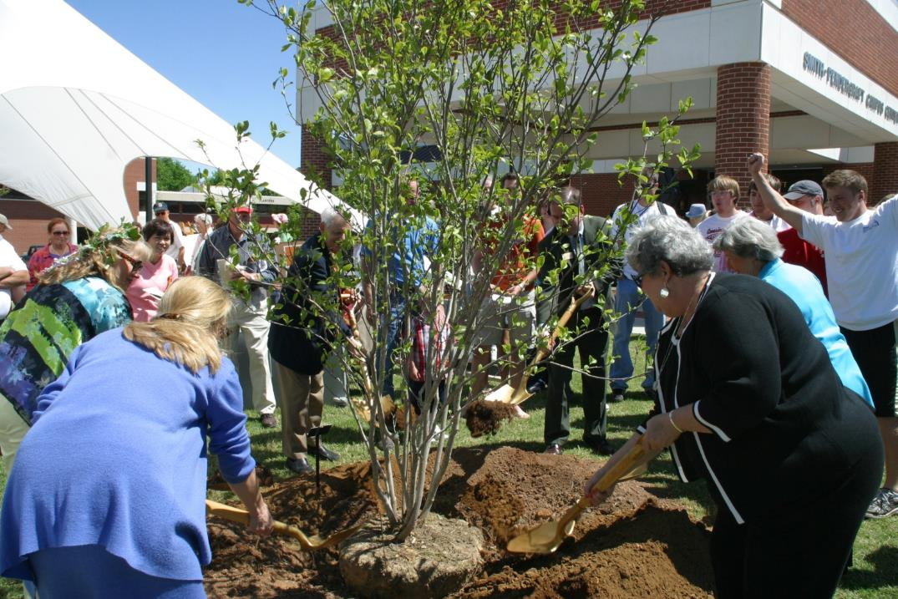
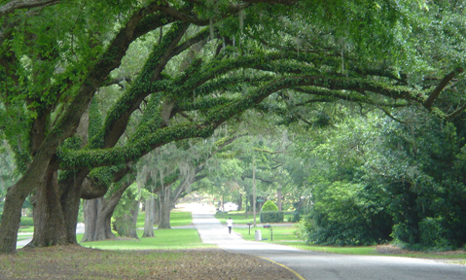
Urban Forestry

Slide 10
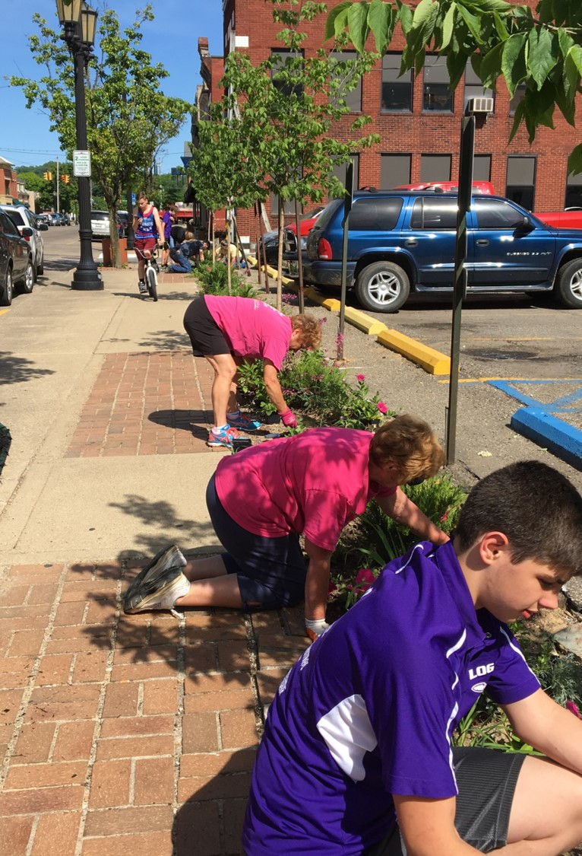
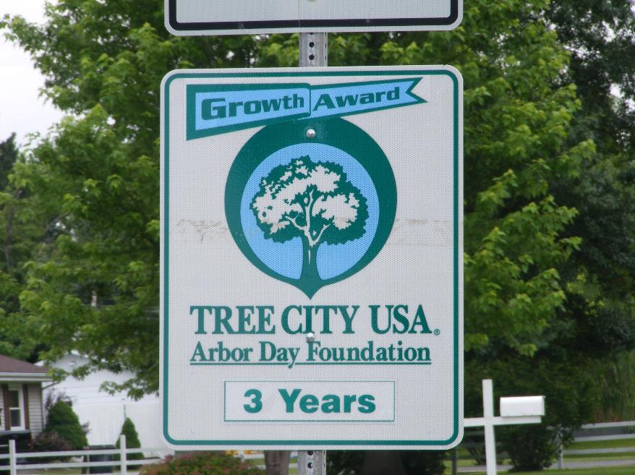
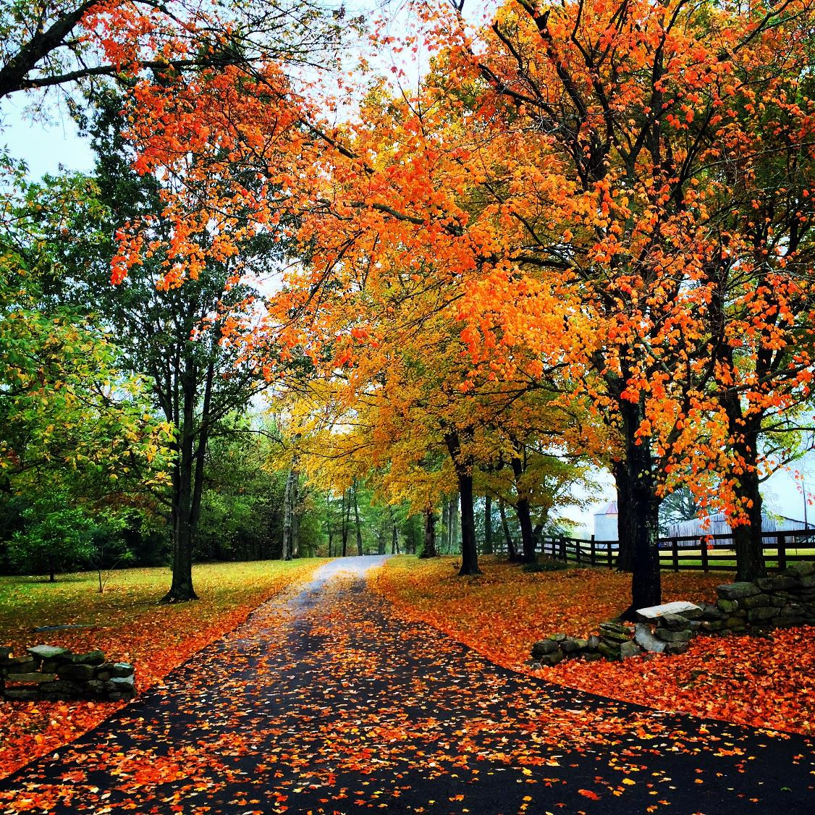

Slide 11
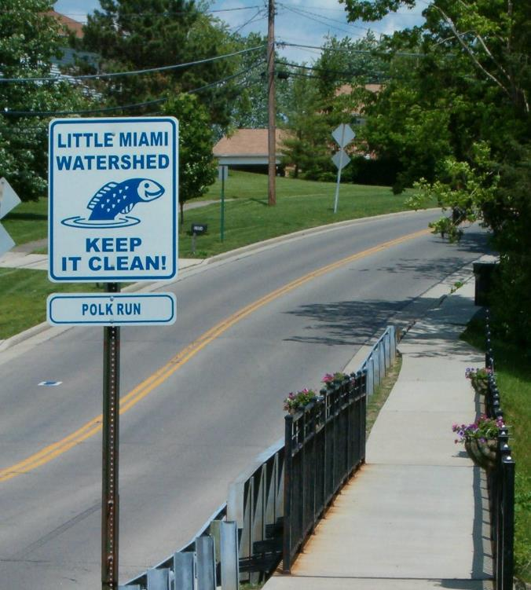
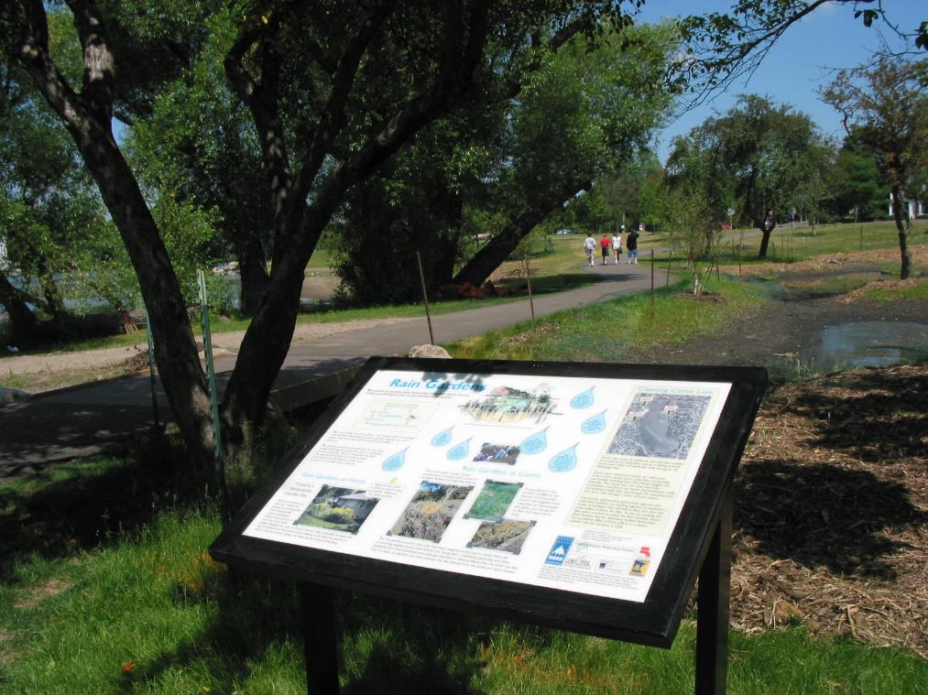
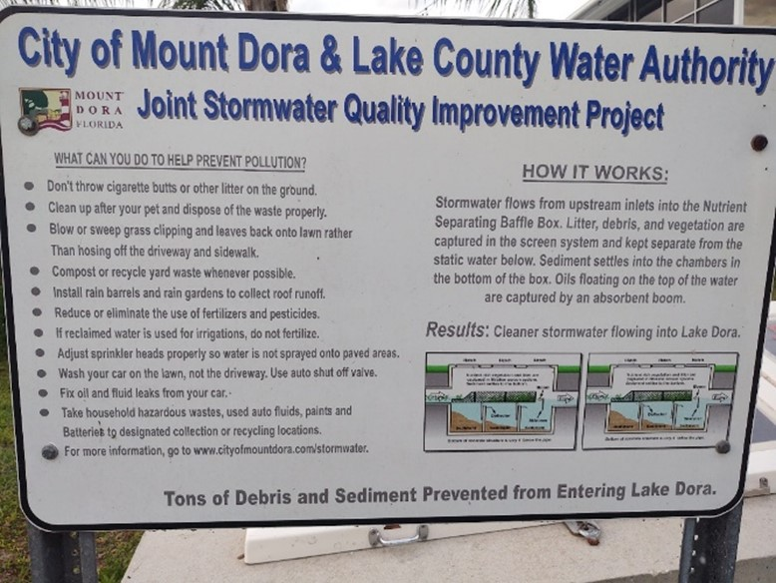
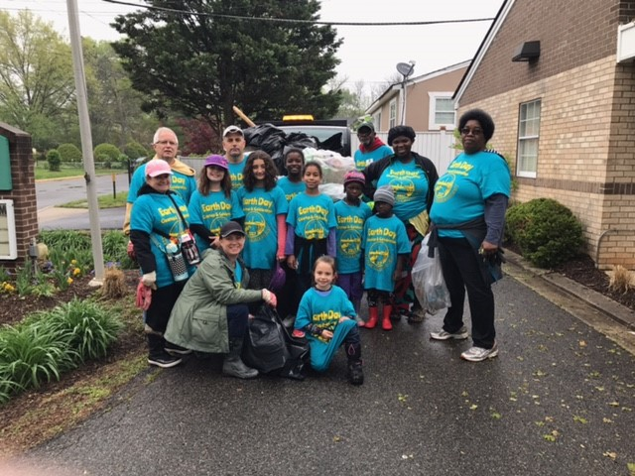
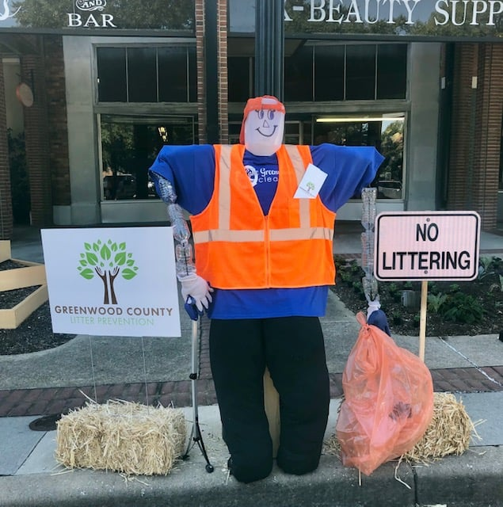
Environmental Initiatives

Slide 12
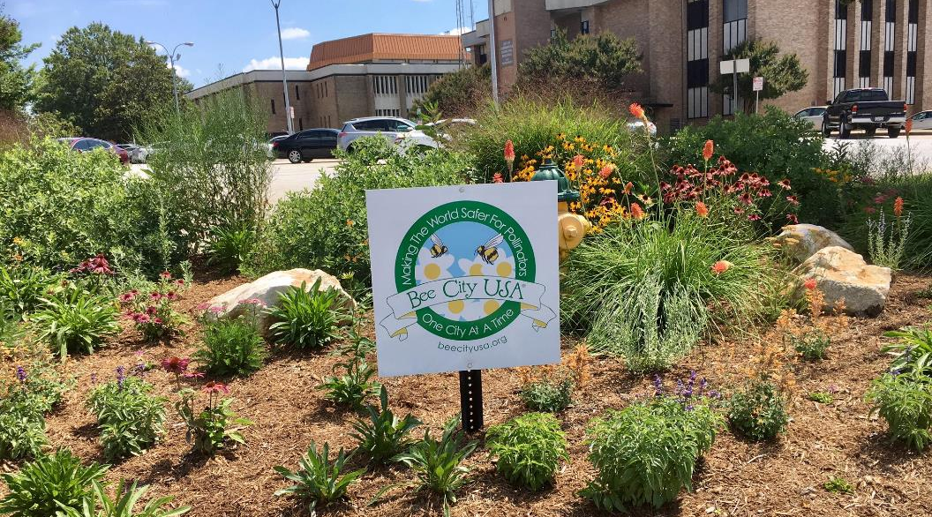
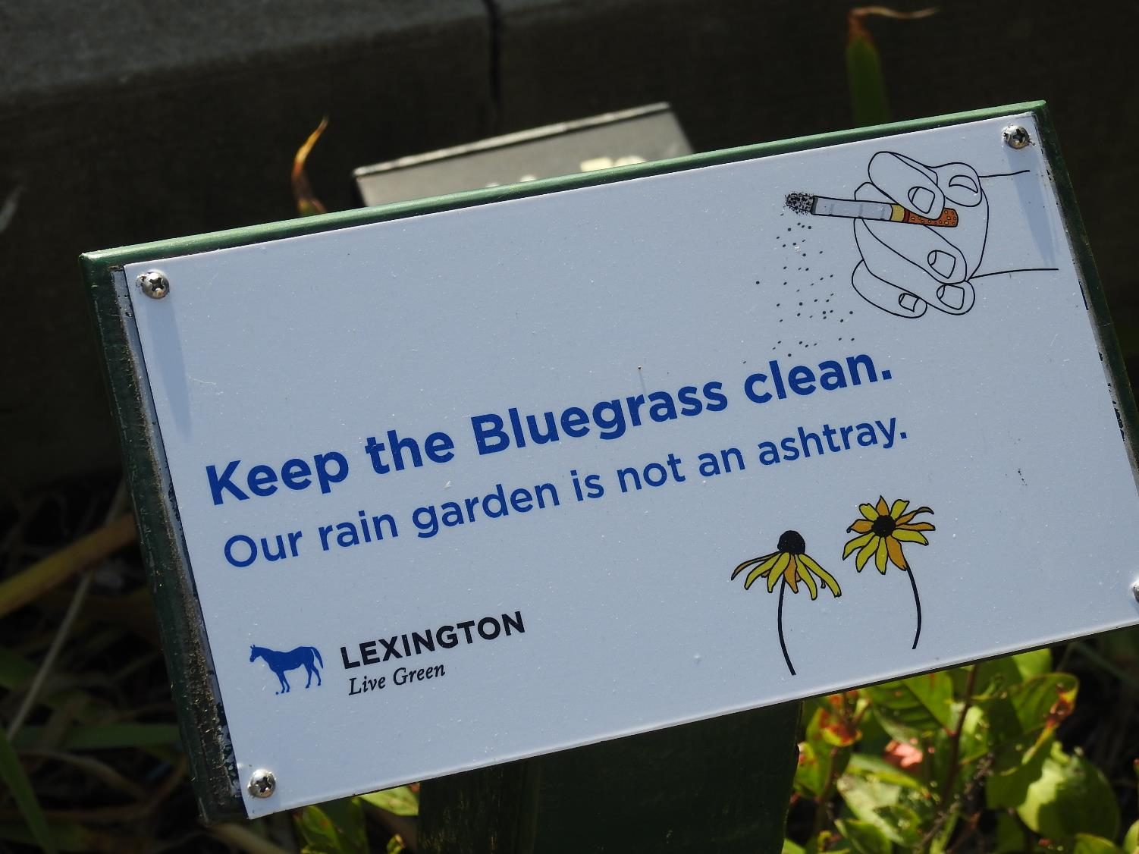
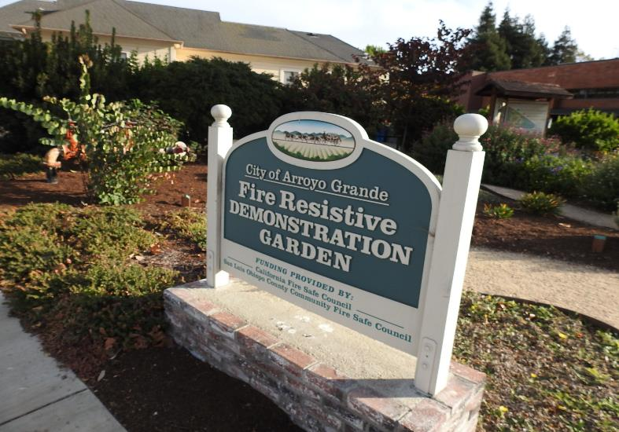

Slide 13
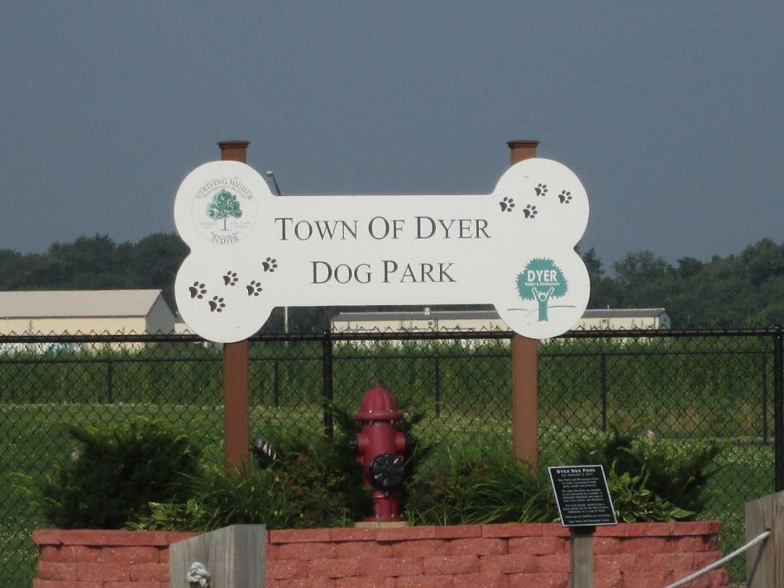
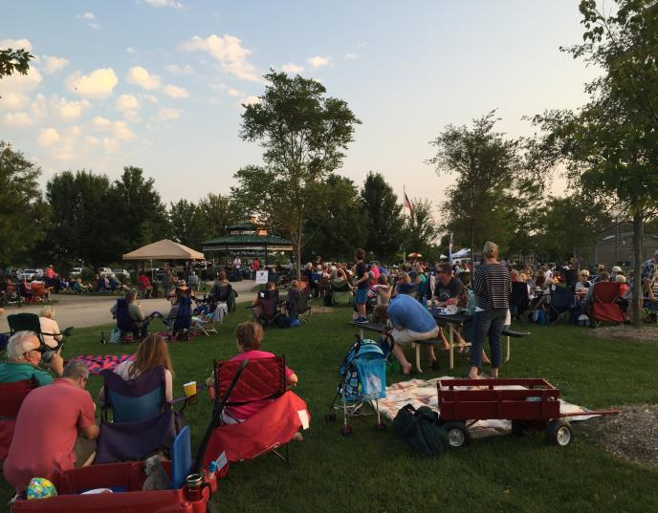
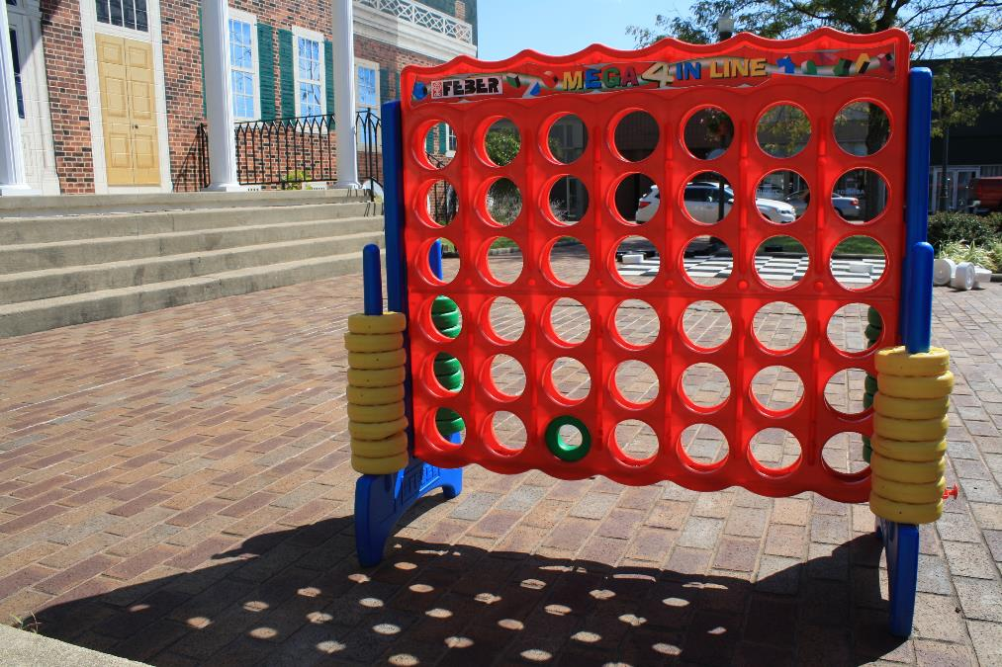
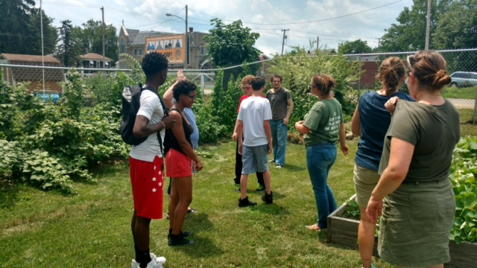
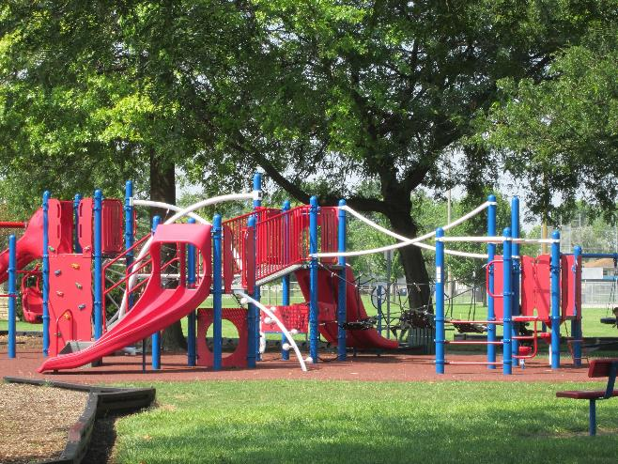
Community Vitality

Slide 14
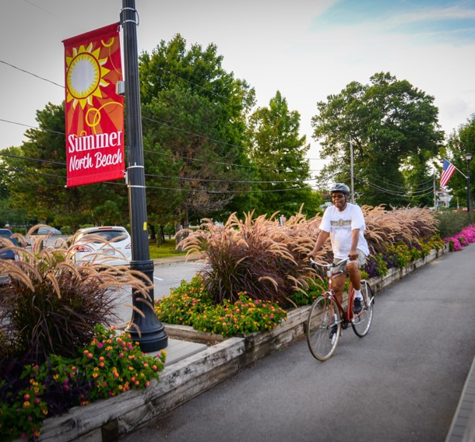
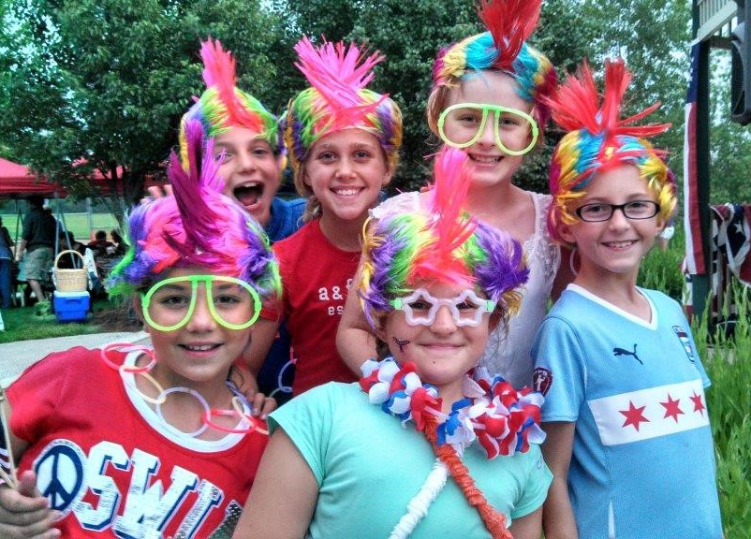
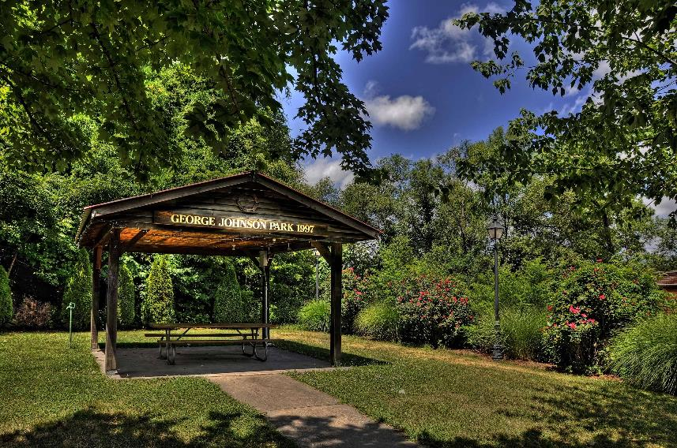

Slide 15
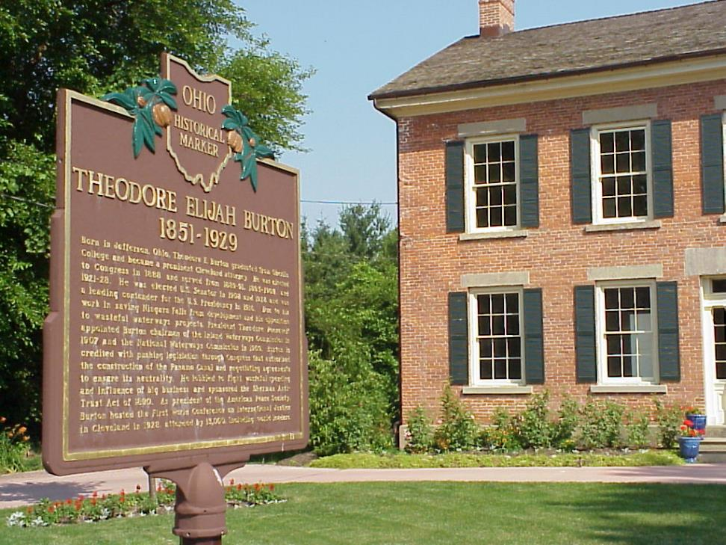
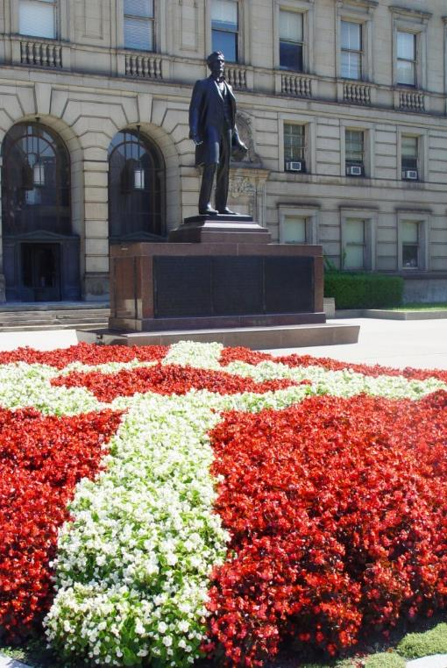
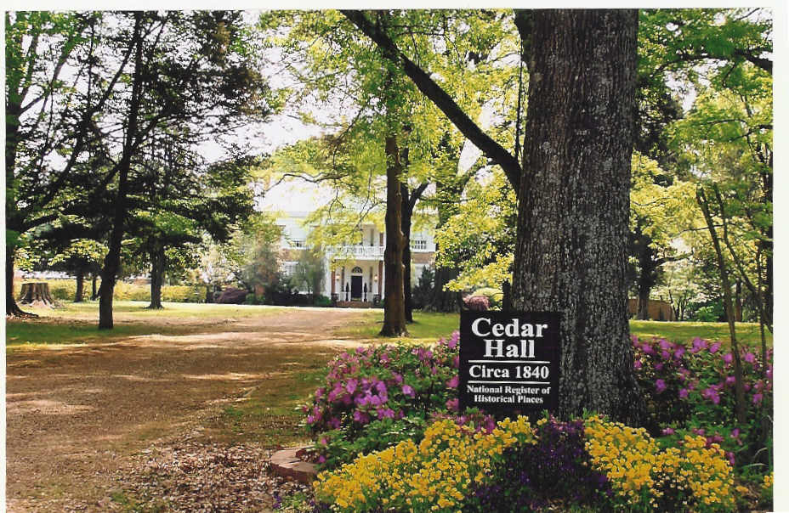
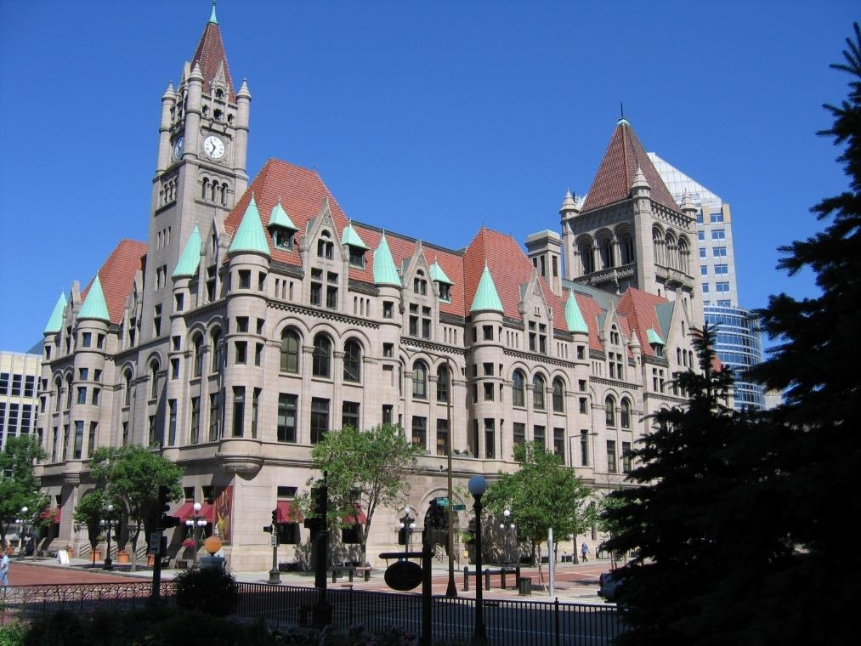
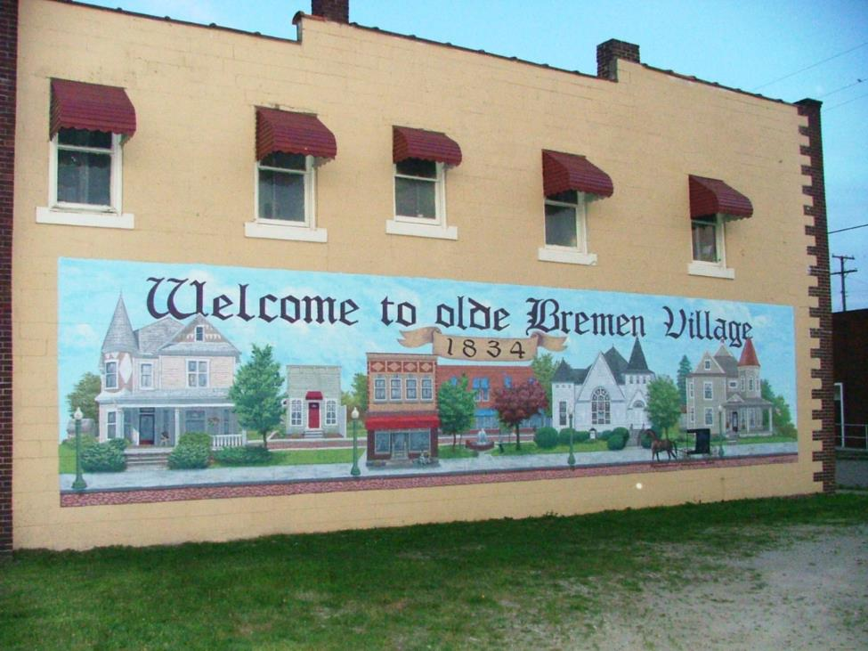
Celebrating Heritage

Slide 16
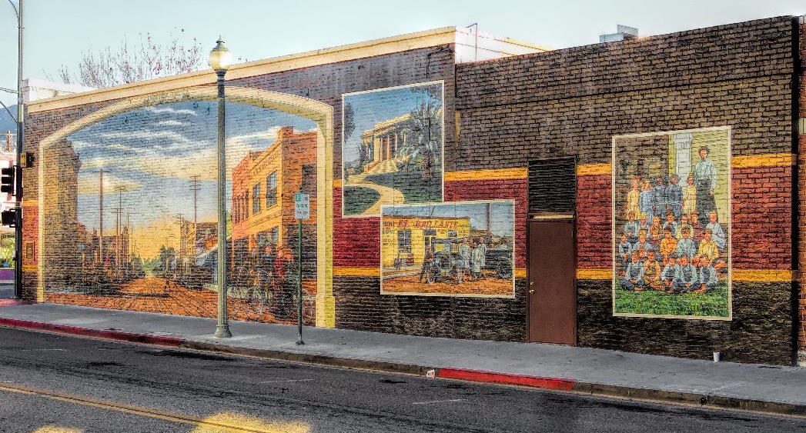
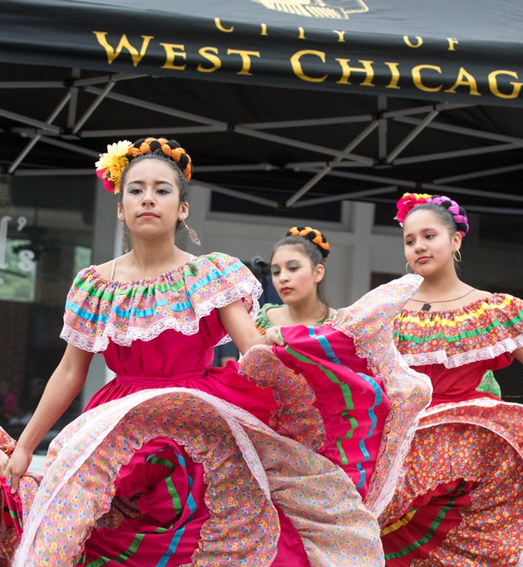


Slide 17





Overall Impression

Slide 18




Slide 19

Symposium & Awards Celebration
3 days of education, learning tours, and awards

Slide 20

Castle Rock, Washington –
Before & After
Notes:
Got involved in AIB perhaps 15 years ago.

Slide 21


Castle Rock Year 1

Slide 22





Slide 23

Ottawa, Illinois - Before & After

Slide 24


Slide 25


Slide 26


Slide 27


Slide 28

A Picture is Worth a Thousand Words:
AIB Communities Across the Country

Slide 29

What Communities Say
“Thank you, America in Bloom, for helping us be the best we can be.”
“AIB brings our community together.”
“The best decision our community ever made was joining America in Bloom.”
“The symposium is my favorite conference to attend each year. I learn so much, I meet nice people, and I have a great time. Thank you, America in Bloom!”

Slide 30


Slide 31

AmericaInBloom.org

